Slide 1
POLST/MOST: Historical Perspective & Current Issues

Slide 2
Karl Steinberg, MD, CMD, HMDC, HEC-C
President, National POLST Collaborative
Past President, AMDA – The Society for Post-Acute & LTC Medicine
Past Chair, Coalition for Compassionate Care of California (www.coalitionccc.org)
Editor emeritus, Caring for the Ages (AMDA/Elsevier)
Podcast Host, JAMDA-on-the-Go and Caring-on-the-Go
NQF—Standing Committee on Geriatrics and Palliative Care
Chair, CMA Council on Ethical, Legal & Judicial Affairs
Delegate, CMA & AMA House of Delegates
Board of Directors, San Diego County Medical Society
Chief Medical Officer—Mariner Health Care, Beecan (SNF Chains)
Medical Director: Hospice by the Sea; Vista View Post-Acute, Carlsbad by the Sea Care Center

Slide 3
Role of Advance Directive
Always check advance directive (MDPOA) first if there is one
To determine decisionmaker
Be diligent about obtaining advance directive, get family to bring in
Or try to get from community PCP
On admission, or have resident execute a new one
Surrogate/agent/proxy (decisionmaker)
The person named in the advance directive
Grammar/usage reminders:
It’s an advance directive, not advanced
A power of attorney is a document, not a person

Slide 4
Is the Value of ACP Controversial?

Slide 5
Is the Value of ACP Controversial?
In my opinion, not controversial at all, research studies and designs notwithstanding:
Incredible value at the bedside for all the reasons discussed
Keeping a LTC nursing home resident who does not want aggressive treatment out of the ICU
Avoiding CPR for a community-dwelling patient you discharged home who wishes “no heroics” when the paramedics arrive
Not putting a feeding tube in a patient with advanced dementia
Alleviating the moral distress of family members in making real-time decisions—whether with or without advance knowledge of the patient’s wishes and desires

Slide 6
A Little National POLST History
1993: POLST became legally recognized in Oregon
2004:
National POLST (then a Task Force) was started - it was combined with Oregon’s POLST program and both were housed in Oregon (same staff)
Program endorsement started to encourage consistency in program implementation and form elements
2017: National POLST moved to DC
2019:
Jan: Officially stopped using “POLST Paradigm”. We are “National POLST” (no Program or Paradigm or Task Force at the end)
May: First in person Plenary Assembly meeting (Austin, TX)
Sept: Introduced National POLST Form
2020: Stopped using POLST as an acronym, but keeping the word “POLST” due to name recognition (kind of like AMDA!)
Notes:
So a little taste of where we've been

Slide 7
What is POLST?
A physician order recognized throughout the medical system
Allows individuals to identify medical goals for care and choose treatments they want to receive and identify those they do not want
Provides direction for health care providers during care for serious illnesses
Notes:
POLST provides direction for a range of end-of-life medical treatments so that health care professionals can provide the treatments patients do want, and avoid those that they do not want.
We’ll take a look at the POLST form itself in a moment.

Slide 8
More History of POLST
Created in Oregon in early ’90s
Legally recognized in Oregon since 1993
Expanded to all states (various levels of penetration and legal status), lots of acronyms
MOST, MOLST, POST, COLST, T-POPP
Grass roots movement, local coalitions

Slide 9
The History of POLST
Certain requirements to meet National POLST guidelines (bright, portable, actionable, voluntary, intended use population), not all states meet them
Some variation in content (e.g., antibiotics, ventilation, combinations of interventions, leeway)
Colorado MOST closely modeled after CA POLST
Generally, all require offering oral feeding
Moving toward more electronic implementation

Slide 10
Revising POLST
National POLST recommends periodically updating the form based on feedback from usage in the field.
Guiding Principle for Revisions: Changes made must provide substantial and significant improvement or clarification to the form.
CA will be revising our form soon in response to the AB1234 legislation creating a statewide registry
Nationally, “POLST” no longer represents an acronym but they have kept the word due to recognition (still our name in CA because it is in statute)
~ “POLST: A portable medical order”

Slide 11
POLST = portable medical orders
“physician” – inaccurate
National POLST policy encourages states to allow all APRNs and PAs be allowed to sign POLST forms
We encourage a team-based approach to POLST conversations
“life-sustaining treatment” – also value-laden (and we want to be neutral)
13 different names! (POLST, POST, MOLST, MOST, COLST, T-POPP, etc.)
Notes:
The next few slides highlight some of the current work and things I want to emphasize:
National POLST no longer uses “POLST” as an acronym but as a term and defines it as a portable medical order. We made this change in early 2019 for a couple of reasons:
1. The prior acronym’s emphasis on “physician” conflicted with national policies promoting a team approach for the POLST process and support for physician assistants and advance practice registered nurses to write and sign POLST orders, a practice National POLST supports and many states allow as I just showed you; and
2. Removes the biased “life-sustaining” phrase: POLST is a neutral form and process that documents what patients want for themselves and patient’s bring their own values to the process in making their treatment decisions;
3. Emphasizes the concept of POLST; and
4. Keeps the national organization neutral in not promoting one name among the many variations on “POLST” acronyms.

Slide 12
National POLST Engagement

Slide 13
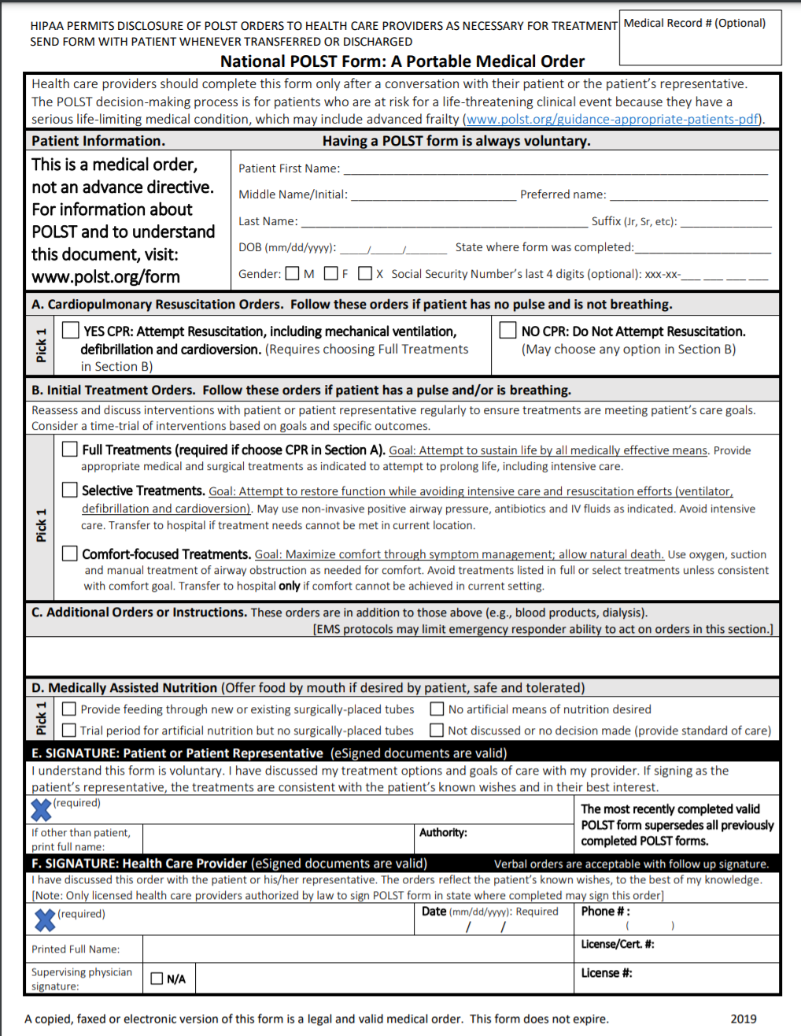
National POLST Form
Notes:
Let’s take a look at the POLST form itself. This is the most recent version of the POLST. It was updated in January 2016 to provide signature lines and instructions for nurse practitioners and physician assistants to sign the POLST, per AB 637. Previous versions of the POLST form remain valid. However, if you have an NP or PA signing POLST forms, they should only use the 2016 form. You can find the date in the upper left corner below the EMSA logo.

Slide 14
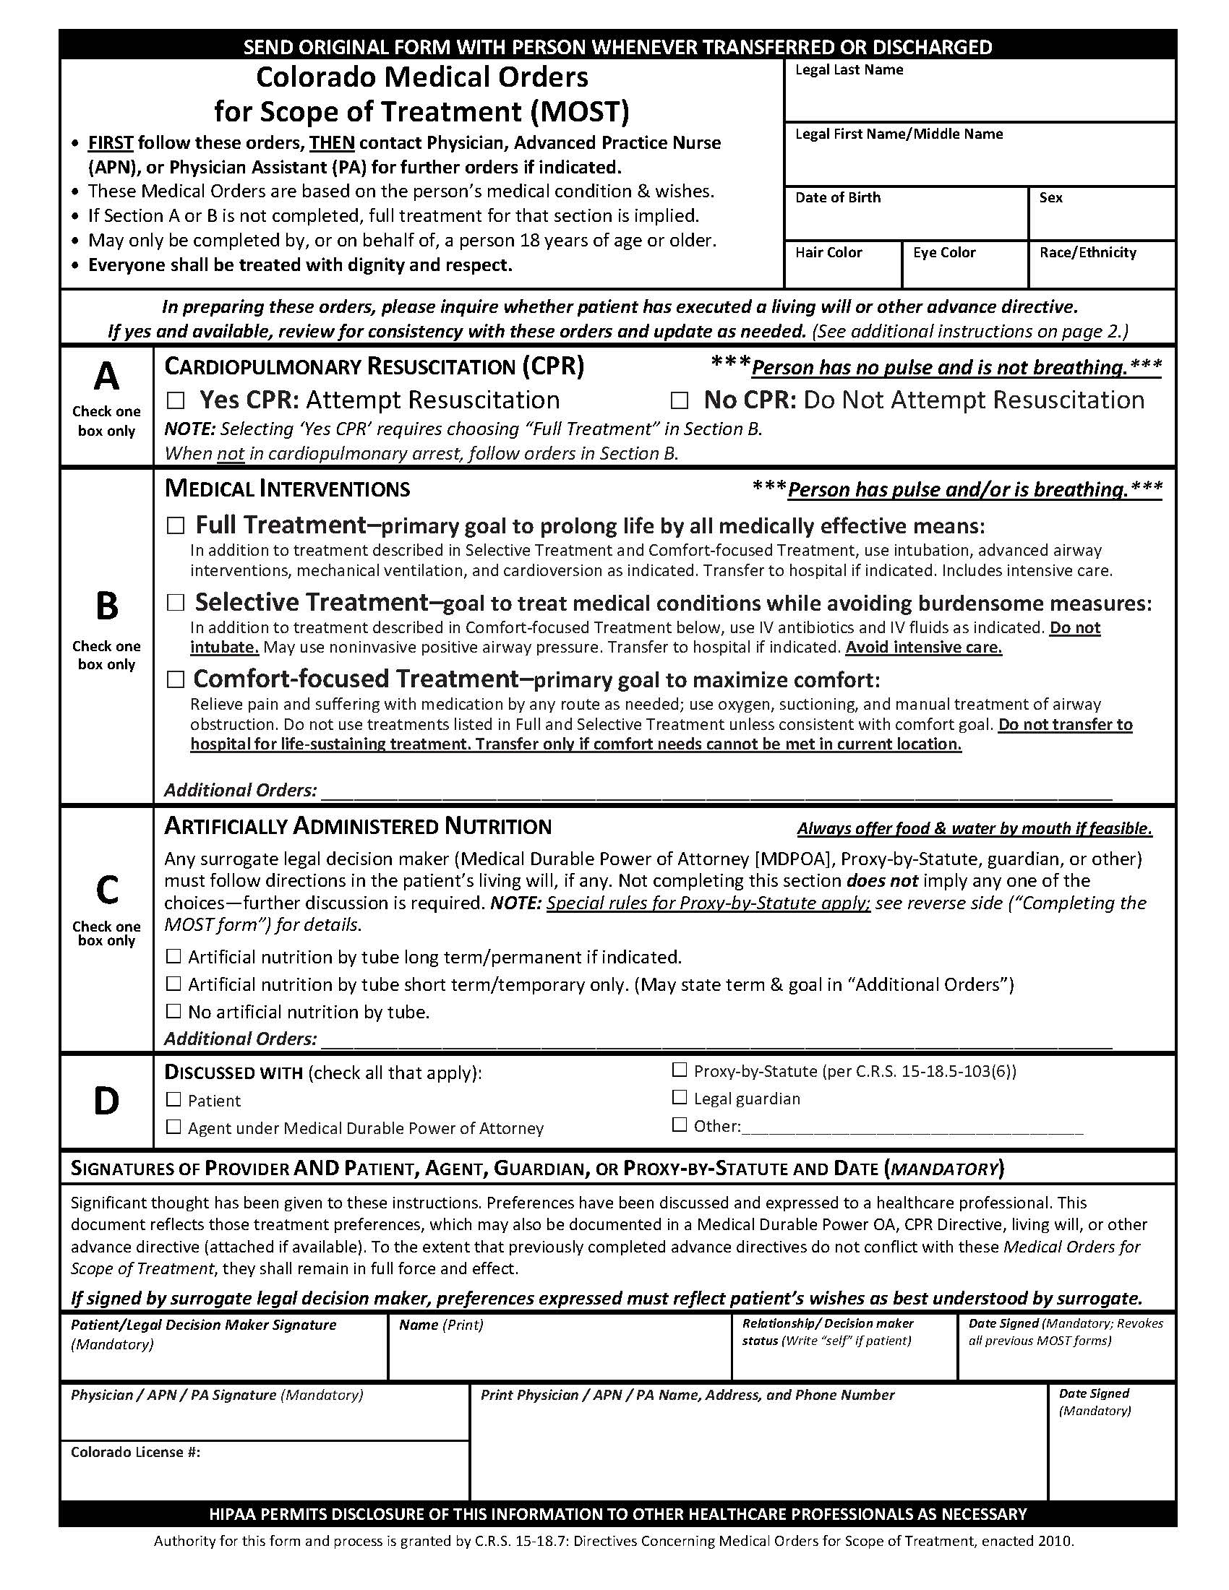
Colorado MOST Form
Notes:
Let’s take a look at the POLST form itself. This is the most recent version of the POLST. It was updated in January 2016 to provide signature lines and instructions for nurse practitioners and physician assistants to sign the POLST, per AB 637. Previous versions of the POLST form remain valid. However, if you have an NP or PA signing POLST forms, they should only use the 2016 form. You can find the date in the upper left corner below the EMSA logo.

Slide 15
Who Would Benefit from Having a POLST Form?
Chronic, progressive illness
Serious health condition
Medically frail
Qualitative tool for determination:
“You wouldn’t be surprised if this patient died within the next year or two.”
* These do not apply to every SNF resident.
https://polst.org/wp-content/uploads/2020/03/2019.01.14-POLST-Intended-Population.pdf
Notes:
Who would benefit from having a POLST form?
POLST is designed for:
Have a chronic progressive illness
Have a serious health condition, or
Are medically frail
Someone not fitting into one of those categories may have a POLST form if that person and their physician agree that it would be a good idea to have one.
There are no age specifications. POLST can be used with both adult and pediatric patients.
A helpful tool for determining who would benefit from POLST is the question, “Would you be surprised if this patient died within the next year.”
This question reflects that determination of who’s appropriate for POLST is an art, not a science.

Slide 16
POLST vs. Pre-Hospital DNR (Do Not Resuscitate) “CPR Directive”
POLST | Pre-Hospital DNR
Allows for choosing resuscitation | Can only use if choosing DNR
Allows for other medical treatments | Only applies to resuscitation
Honored across all health care settings | Only honored outside the hospital
Notes:
There are differences between the two forms however.
POLST:
Allows for choosing resuscitation in addition to saying no to it.
Allows for decisions about other medical treatments, such as artificial nutrition.
Is honored across all health care settings (in the SNF, clinics, hospitals, home, EMS System, etc.) - the Pre-Hospital DNR is a medical order that is honored outside of the hospital only (home, assisted living, SNF, EMS System).
POLST is more comprehensive than the DNR form.

Slide 17
Current POLST Form
Previous (2011) POLST Form

Slide 18
When Does Section A Apply
Resident has died a natural death
No heartbeat
Not breathing
Important for people to know that checking DNR/AND does not mean “Do Nothing” in situations short of a full cardiac and respiratory arrest
Useful to communicate that CPR is not very effective in frail elderly patients, and can cause serious harm for those who survive

Slide 19
Diagram of POLST Medical Interventions
CPR
DNR
Full Treatment*
Selective Treatment
Comfort-Focused Treatment
*Consider time/prognosis factors under “Full Treatment”
“Trial Period of Full Treatment” may be checked if prolonged life support is not desired.
Notes:
Choosing “Attempt Resuscitation / CPR” in Section A requires choosing “Full Treatment” in Section B: Medical Interventions.
It is not acceptable to request “Attempt CPR” and “Selective Treatment” or “Comfort-Focused Treatment”.
If a person wants CPR, they must be willing to have ACLS (Advanced Cardiac Life Support) guidelines followed, which usually includes intubation and care in the ICU.
“Do Not Attempt Resuscitation / DNR” may be chosen with any of the Medical Interventions in POLST Section B.
“DNR” may be chosen with “Full Treatment.” This applies to the patient who has a pulse and/or who is breathing and wants aggressive medical interventions, but who doesn’t want to be resuscitated if found without a pulse or not breathing (they have died).
It is important to address length of treatment, severity of illness, and prognosis with this option.
Ask the patient, “If you did not get better and doctors thought your chances of a good recovery were very poor, would you want to be kept alive on the ventilator?” If the patient does not want to be kept on prolonged life support, the box under Full Treatment, “Trial Period of Full Treatment” can be checked.
Possible additional orders might relate to dialysis, chemotherapy, blood transfusions, or AICDs (automatic implantable cardioverter defibrillator). Note if patient has an AICD so it can be deactivated at the end-of-life.

Slide 20
Changes to Section B— Goal Statements
In 2014 Revisions, Section B statements reflect goals of care as opposed to just descriptions, also does not use the language “Comfort Care Only” or “Limited Interventions”
Also added “time-limited trial” of full treatment
Also modified the order of all sections to be consistent, most aggressive to least aggressive

Slide 22
Section B – Full Treatment
Full Treatment
Full use of all hospital has to offer
Including ICU & intubation/ventilation, dialysis, etc.
Invasive, intense, aggressive
CPR = most invasive/aggressive intervention
Those choosing CPR in Section A must choose Full Treatment in Section B
Can be for trial period (not on CO MOST), either a specific time or just left blank and defer to decisionmaker

Slide 23
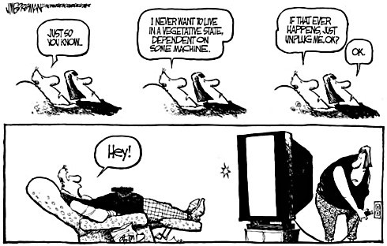
Context is Important
BMJ 2010;340:c1345, doi: 10.1136/bmj.c1345 (Published 23 March 2010)
Kass-Bartelmes BL, Hughes R, Rutherford MK. Advance care planning: preferences for care at the end of life. Agency for Healthcare Research and Quality; 2003. Research in Action Issue #12. AHRQ Pub No. 03-0018. SUPPORT Study
Advance Care Planning: Pitfalls and Progress; Pendergast

Slide 24
Section B – Selective Treatment
Selective Treatment
Most complex category
Not ready for comfort ONLY, but want less invasive treatment
No ventilator / intubation
Think twice before surgery or ICU
Treat treatable conditions if not too burdensome
What many people would consider “No Heroics”
Do Not Transfer option
Acknowledges residents who want these treatments in SNF, but not hospital—but still transfer if comfort needs can’t be met
Can’t really do this in AL/RCFE except if on hospice (Title 22)
Notes:
Transfer can be burdensome

Slide 25
Section B – Comfort-Focused Treatment
Comfort-Focused Treatment
Everyone gets comfort care
Whether box is checked or not
Choice is mostly for residents at end of life—interventions designed to prolong life not wanted
Care plan should be consistent
Evaluate all treatments and meds, many appropriate to stop—usually no antibiotics for infection
Change in condition – Evaluate
For example, broken hip may need surgery to address pain, which promotes comfort

Slide 26
Section C – Artificial Nutrition
Oregon removed tube-feeding from its POLST
(Never an emergency decision, and can potentially encourage an option that is contraindicated)
Other states and National have not followed suit
Important to recognize that tube-feeding is considered contraindicated by most reputable professional societies (AAHPM, AMDA, AGS) in patients with advanced dementia
Choices are no TF, trial period TF, long-term TF
Valuable to educate patients about dying from dehydration/hypovolemia—not a bad way to go

Slide 27
Section C
2016 POLST Form
2011 POLST Form

Slide 28
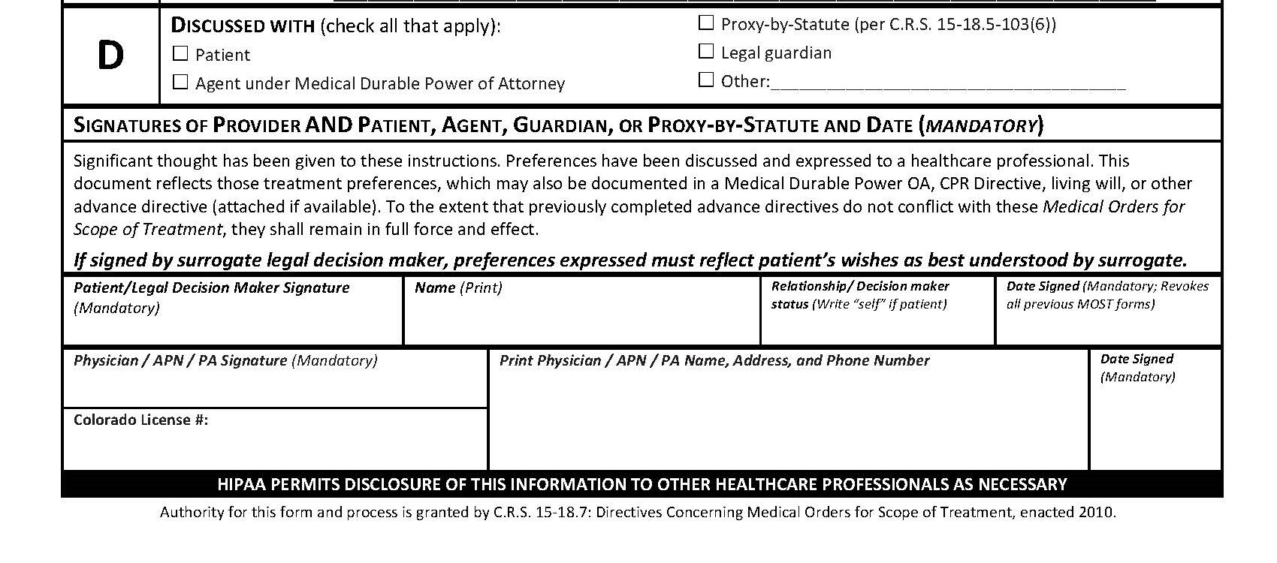
CO MOST Form Section D

Slide 29
Wise Guidance from CA Probate Code §4650
Legislative Findings:
(a) In recognition of the dignity and privacy a person has a right to expect, the law recognizes that an adult has the fundamental right to control the decisions relating to his or her own health care, including the decision to have life-sustaining treatment withheld or withdrawn.
(b) Modern medical technology has made possible the artificial prolongation of human life beyond natural limits. In the interest of protecting individual autonomy, this prolongation of the process of dying for a person for whom continued health care does not improve the prognosis for recovery may violate patient dignity and cause unnecessary pain and suffering, while providing nothing medically necessary or beneficial to the person.
(c) In the absence of controversy, a court is normally not the proper forum in which to make health care decisions, including decisions regarding life-sustaining treatment.

Slide 30
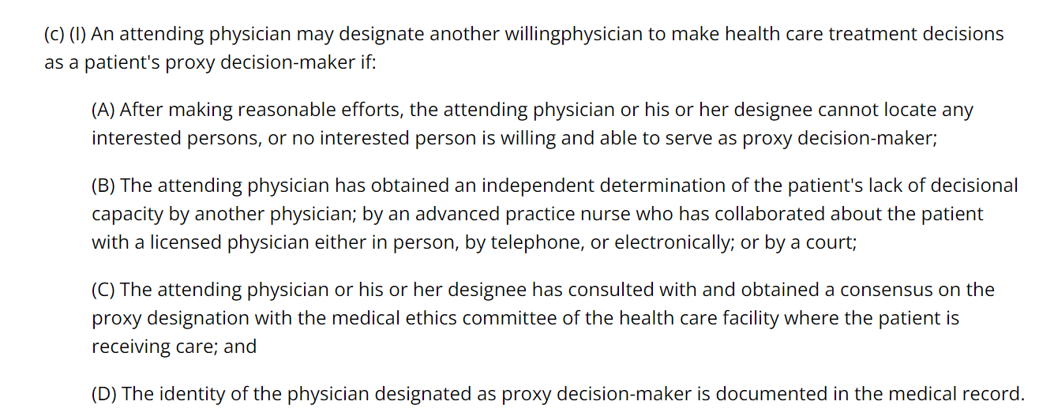
Incapacitated Patients – CRS § 15-18.5-103
https://law.justia.com/codes/colorado/2018/title-15/declarations-future-medical-treatment/article-18.5/section-15-18.5-103/

Slide 31
Uniform Laws Commission Surrogate Language
In descending order of priority:
an adult who the individual has designated in an advance health-care directive or in another manner; the individual’s spouse[or domestic partner], unless legally separated;
the individual’s adult child or parent;
the individual’s cohabitant;
the individual’s adult sibling;
the individual’s adult grandchild or grandparent;
an adult not listed in paragraphs (1) through (6) known to have routinely assisted the individual with supported decision making during the past six months;
the individual’s adult stepchild not listed in paragraphs (1) through (7) who the individual actively parented during the stepchild’s minor years and with whom the individual has an ongoing relationship; or
an adult not listed in paragraphs (1) through (8) who has exhibited special care and concern for the individual and is familiar with the individual’s personal values.

Slide 32
Practitioner Signature & Engagement
POLST not valid without physician/NP/PA (and patient/surrogate) signature
Don’t place/upload into chart without it
Newer e-versions will ensure required elements are present & no conflicts
Physician/NP/PA should validate choices
Consistent with prognosis and preferences
Don’t sign before discussion completed
Best practice – Physician/NP/PA takes lead

Slide 33
Updating a Patient’s POLST
Recommendation: Update POLST forms to the most recent version when reviewing older POLST forms.
Previous versions of POLST forms will still be valid.
Even though many people’s POLST wishes never change, it should be reviewed periodically
White paper, photocopies, faxes, e-mailed POLST orders are valid
When POLST orders are changed or updated, old forms should be voided
Conversations surrounding POLST completion should be documented and (ideally) easily available

Slide 34
POLST Registries
Oregon has statewide POLST registry mandated by law and paid for by physician license fees
California passed AB 1234 in 2022, creating e-POLST registry. Previous pilots (SD, A/CC).
New York has e-MOLST available
Without mandatory completion by healthcare professional, may not be updated reliably
But a great idea!
Video tools (patients in their own words, etc.)

Slide 35
POLST Current Issues
Advance Care Planning Codes (99497/99498) billable since 2016, perennially under attack – more recently from within (e.g., Morrison et al). Please advocate for appropriate ACP!
Especially for designating a surrogate at all ages.
https://geripal.org/polst-evidence-and-update-kelly-vranas-abby-dotson-karl-steinberg-and-scott-halpern/
Political climate in some states may be hostile to withdrawing/withholding aggressive life-prolonging treatment
National POLST Collaborative wants to be sure that POLST is not being used in inappropriate patients (like “Welcome to Medicare,” etc.)
Widespread use in nursing homes, sometimes without a good conversation, sometimes in fairly healthy patients—use as an essentially mandatory code status document
MAID/VSED: Obviously, be sure they have POLST

Slide 36
POLST Pain Points in SNF
Nurses/docs send patients to hospital who shouldn’t be sent based on their goals of care (or vice versa)
People do not realize that “DNR” does not mean “let the patient die” and take less action than appropriate
Family members sign forms when patient has capacity (which is OK if patient requests it, but not in general)
Paper forms are sent to hospital and never returned
A variety of errors on forms, e.g.:
Only the resident signed, not the doctor/NP/PA
Section A yes to CPR, but “selective” or “comfort” in B
Section A left blank
Neither box checked as far as patient’s capacity

Slide 37
POLST Pain Points in SNF (cont’d)
Forms not sent home with patient or faxed to PCP on d/c
New POLST filled out every admission despite no changes to wishes or goals of care
Pt. has just filled out POLST at hospital and brought it, but SNF requires resident to fill out a new one
Questions (at hospital or even with first responders) about quality of POLST conversations and validity of the POLST completion process in some SNFs
Biggest Pain Point: POLST being completed on patients who merely want default treatment initially with a change of condition: Please do not participate in this. They do not need a POLST.
civhc.org/wp-content/uploads/2023/09/10-Tips-to-Use-MOST-in-Care-Communities_2023-Upadte.pdf

Slide 38
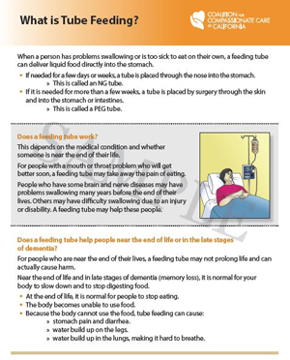
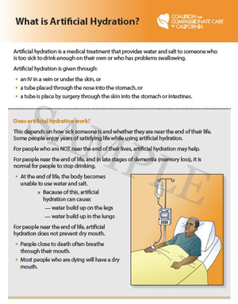
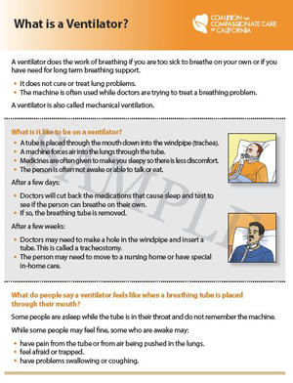
Decision Guides from CCCC
CPR ● Tube Feeding ● Hydration ●Ventilator

Slide 39
ACP/POLST: Tools and Resources
CIVHC MOST: https://civhc.org/programs-and-services/most-program/
Colorado Care Planning: https://coloradocareplanning.org/
National POLST: www.POLST.org
Coalition for Compassionate Care of California: www.coalitionccc.org
Aging with Dignity/ Five Wishes: www.fivewishes.org
Shiley Haynes CSU Institute for Palliative Care: www.csupalliativecare.org
Caring Connections: Planning Ahead: www.caringinfo.org
Caring Advocates (Dementia): www.caringadvocates.org includes some advance directives for dementia (SED by AD)
California POLST: Physicians’ Orders for Life Sustaining Treatment: www.capolst.org
Prepare for Your Care: www.prepareforyourcare.org
The Conversation Project: www.theconversationproject.org
GO WISH Cards: www.gowish.org

Slide 40
Thanks for All You Do!

