Slide 1
Re-Thinking Rituals Around the Holidays
Each family has their own unique set of traditions and rituals when it comes to big occasions. During the winter holiday season, these rituals provide families with a sense of predictability: Mom’s famous pumpkin pie, Auntie’s notorious vacation photos, and so on. Since the start of the pandemic, families have had to adapt their rituals during the holiday season.* This requires flexibility and resilience, two skills we’ve used a lot the past year plus. Here are some tips to get you thinking about flexing your flexibility and resilience this holiday season:
1. Continue to celebrate. Celebrations this year may still feel different. While we have progressed, we may not be back to exactly how things were before the pandemic. It’s ok to continue to adapt your holidays for each family members’ situation and comfort level. You may do a zoom call with your grandmother but have your brother come over for Thanksgiving dinner. Try not to put too much pressure to go “back to normal”, it’s ok to continue to be flexible.
2. Make space for positive and negative feelings. This year you may still feel those unpleasant emotions around the (supposed to be) “joyous holiday season”. Disappointment and frustration that the pandemic is continuing, just to name a few. It’s ok to still have and make room for these emotions… in fact, you should allow yourself to feel these emotions. Maybe during family time ask: “What has been the hardest part of the pandemic? How have you navigated it?”
Dissecting & Re-thinking Rituals:
What is the ritual? – The behavior/ritual. Example: Making a meal for a family in need.
Why is it important? – The value. Example: Giving back to the community
Is the ritual realistic to do this year? – Feasibility. Example: No, sharing food and eating together still makes some of us nervous.
What are other more feasible ways to live out that value? – The solution. Example: Individually wrap treats and share them at the community center for contactless distribution.
How can we include those who are less comfortable with the new ritual? Example: Aunt Dottie is still apprehensive about traveling to Mom’s house to bake, so she will pitch in by picking out recipes and making a shopping list.
3. Find the family value behind the ritual. Our rituals are strongly linked to our family values. When adapting rituals, continue to focus on the value, rather than the behavior that comes from the value (that is the “ritual”). Try to make changes that preserve your family values, even if it looks very, very different.
4. Connect with your loved ones. Plan for how you will connect with loved ones during the holidays (Who will you call on the phone? Who will you see in person? Who will you have a Zoom call with?). Make sure to coordinate ahead of time so everyone knows when and how you’ll be in contact. This is especially important for your care community, so they can make sure the appropriate assistance is available.

Slide 2
5. Accommodate the whole family. We all have different comfort levels around travel, social distancing, dining, etc. It is important to respect each persons’ level of apprehension to try to understand their perspective and accommodate everyone’s comfort level.
Communicating & Negotiating Risks
 | If others are MORE apprehensive: | If others are LESS apprehensive:
Step 1: Identify the situation | I was hoping we could go out to dinner. | On Saturday night, I made reservations at a restaurant for us.
 | I don’t feel comfortable dining inside. | Thank you for doing that. Although, I don’t believe I feel comfortable eating inside.
Step 2: Understand the perceived risk | I understand your apprehension. Just so I’m clear though, can you tell me what it is that specifically worries you? | Well, it’s December so it will have to be inside.
 | I don’t trust these restaurants to keep us distanced. I have a chronic condition and I’m scared. | I’d like to tell you my worry so we can reach a resolution because I would love to all eat together. Because I have a chronic condition, I am still worried about being inside while eating. I see eating indoors as still a high risk for me.
Step 3: Find a risk level everyone is willing to take on for the benefits of the activity | I understand that. I really want us to enjoy a meal together. What level of risk would be comfortable for you to dine with us? | I understand that. I just really want us to enjoy a meal together.
 | I think I’d feel more comfortable with take out. Maybe we can even get paper plates so you don’t have to clean up? | I know and I really want to do that. I think the most exposure I’m willing to risk is if we do take out. I’m more than happy to help make that happen.
6. Don’t be ashamed to stay safe. It’s ok to prioritize safety this year. If you feel unsafe or uncomfortable continuing a previous Holiday ritual, you don’t have to. Expect that some families will continue their rituals as normal, and post these to social media. Don’t let this make you feel guilt or shame. Making a commitment of safety to your family is a way of showing love. This year, focus on flexibility, and take time to acknowledge yourself and your family for being adaptive.
Have a joyous holiday season!
*Please seek guidance from your local governance, trusted public health sources, and your residential care community regarding safety protocols during this year’s holiday season.
Evan Plys, PhD is a professional geropsychologist and Assistant Professor of Psychiatry at the University of Colorado School of Medicine.

Slide 3
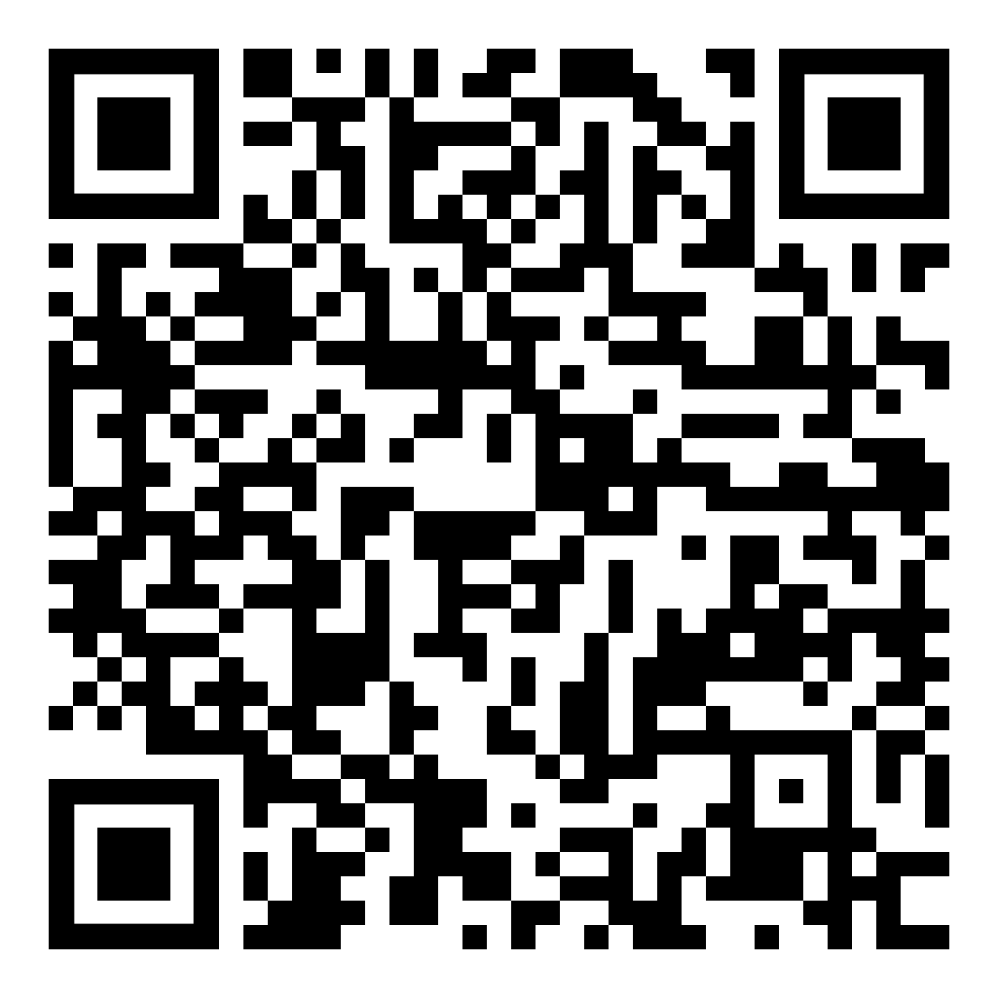
Planning a Meaningful Remote Visit during COVID-19
Shifting from an in-person to outdoor or video visit can be challenging. These types of visits often require a little more planning.
Consider these tips for your visits:
Conversation Topics
Write out conversation topics, such as family news, current events , or other shared interests like sports, fashion, celebrity gossip, etc.
tap into the wisdom of aging and ask your loved one how this experience has changed or confirmed their views of themselves, life, or the world.
Reminiscence is also a great way to maintain supportive communication and has mental health benefits.
Prompts:
Tell me about a time when it felt like everyday life drastically changed as a result of what was going on in the world.
Tell me about all the different ways you’ve stayed informed of the news throughout your life.
How did you entertain yourself when you were bored as a child, teenager, adult
Reminiscence has the added bonus of helping you and you loved one find strengths that previously helped through other life challenges.
Activities
Remote visits may be an opportunity to engage in activities like creating a family tree, photo album, or legacy video. Other tips for virtual visit activities include:
Tour a museum or landmark or even NASA together… for free!
Engage in an activity together through Mather Senior Care or the Alzheimer’s Foundation of America
Watch and discuss an inspiring film about aging
View an opera, musical, or theatre performance
Listen to a poem
Scan for more online
activities
Evan Plys, PhD is a professional geropsychologist and Senior Instructor of Psychiatry at the University of Colorado School of Medicine.

