Slide 1

A Trusted Source
The Latest on COVID 19 Vaccines and the Pandemic
September 2021

Slide 2
Update on the Delta Variant and COVID 19: The Facts
      We are not done yet fighting the virus yet, but we have much better tools now
      The Delta variant is more infectious and more deadly than the original virus
      Patients are younger and get sicker more quickly
        “The delta variant is not last year’s (COVID 19) virus, and it's become incredibly apparent to healthcare workers that we are dealing with a different beast.” Catherine O'Neal, MD, an infectious disease physician

Slide 4
What’s the latest about the COVID 19 vaccines?
On August 23, 2021, the U.S. Food and Drug Administration (FDA) granted full approval of the Pfizer COVID-19 vaccine for the prevention of COVID-19 disease in people ages 16 years and older.
The vaccine continues to be available under emergency use authorization for adolescents ages 12 to 15 years, and for the administration of a third dose in immunocompromised people.
As of August 26, 2021, 203 million people in the United States have received at least one dose of a COVID-19 vaccine.

Slide 5
Are the COVID 19 Vaccines Safe?
Yes!
The FDA and CDC are using the same standards that they always use to evaluate a vaccine. No standards have been changed and no steps for evaluation have been skipped.
FDA advises a minimum of 3,000 participants to assess safety. The three vaccines that are authorized to use in the US had trials with 30,000 to 50,000 participants. Now we have over 2 billion people who have taken the COVID 19 vaccines.
We have an effective safety monitoring system.
Side effects happen for vaccines within 6 weeks of getting vaccinated. We have an enormous amount of information on the safety of these vaccines now because so many people have been vaccinated!

Slide 6
Will the mRNA COVID 19 vaccines change my DNA?
No
mRNA technology has been used for over 10 years for other medical treatments (including cancer treatments) and we know a lot about this technology
mRNA is like a school bus and your DNA is in the classroom: The school bus cannot get into the classroom.
The mRNA does not last in your body for more than a few days.

Slide 7
“What does the COVID 19 vaccine really do? People who have been vaccinated are still getting COVID.”
  All 3 of the COVID 19 vaccines protect against the COVID 19 variants including the Delta variants
  IT IS OUR BEST TOOL AND WILL SAVE YOUR LIFE AND THE LIVES OF THE PEOPLE YOU CARE FOR AND CARE ABOUT, especially our kids who are not yet old enough to get vaccinated
  Let’s be clear: what is the vaccine supposed to do?
    Protects against severe disease, hospitalization, need for a ventilator, and death
    Protects those around you who may be immunosuppressed, on cancer treatments
    Helps prevent more variants from forming and thereby help stop the pandemic for all of us
  There will be breakthrough cases and that is expected. Almost all people who have breakthrough cases do not get severely sick, because of the vaccine!

Slide 8
Why should I get the COVID 19 Vaccine ?
To protect yourself, your family, coworkers and residents
It is all about safety and survival
  We put on our seatbelt
  We do wound care
  We have received other vaccines (e.g., measles and tetanus)
It will help end the pandemic and get our lives back
To act with purpose and be part of the solution
The vaccines are safe and effective

Slide 9
COVID 19 Vaccine: Answers to current common questions
Is it still worth it to get the vaccine?
  The vaccine was created to prevent severe disease, hospitalization, the need for a ventilator and death
  The COVID 19 vaccine does all these things
What about breakthrough cases?
  Breakthrough cases are expected and does not mean the vaccine has failed
  Breakthrough cases are usually mild (No hospital, ventilator or death)
Two key statistics to know:
  In the US now 95%-99% of hospitalizations are in people who are not fully vaccinated
  In the US now over 99% of the people who are dying from COVID 19 are not fully vaccinated
  https://www.kff.org/policy-watch/covid-19-vaccine-breakthrough-cases-data-from-the-states/

Slide 10
What about Booster Shots?
Why are boosters needed?
  We now see that our protection decreases over time
Who should get boosters and When?
  The ACIP (CDC advisory committee) now recommends boosters for some immunocompromised people who have received a mRNA vaccination
  It appears that boosters will now be recommended 8 months after the second mRNA vaccine shot, and may be available starting September 20, 2021 (Pfizer)
  J&J COVID 19 vaccine has also just released some data that an additional J&J COVID 19 vaccination 8 months after the initial J&J shot is very effective and increases protection
  FDA would have to amend the EUA for COVID 19 vaccines or amend an approved COVID 19 vaccine to allow for a booster shots for any vaccine
https://www.jnj.com/johnson-johnson-announces-data-to-support-boosting-its-single-shot-covid-19-vaccine
https://www.fda.gov/news-events/press-announcements/coronavirus-covid-19-update-fda-authorizes-additional-vaccine-dose-certain-immunocompromised

Slide 11
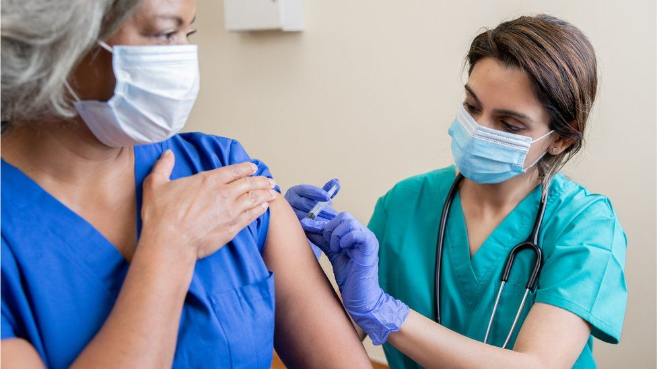
Why Should I get vaccinated if I have already had a COVID 19 infection or suspect that I did?
We don’t know how long your protection will last or how much protection you will have against new variants, like the delta variant
The immunity from the COVID 19 vaccines appears to be more durable and protective, especially against some variants that are more contagious and dangerous than the original virus.
The COVID 19 vaccines have undergone numerous trials and we continue to monitor immunity after vaccination
Antibody tests are not adequate to make a decision about getting the vaccine.
Research shows that people who had COVID-19 and get vaccinated have an enhanced immune response and strong resistance against variants of concern (JAMA, July 14, 2021)
August 6, 2021:CDC research showed Unvaccinated adults who were previously infected with COVID-19 were twice as likely to be reinfected as those previously infected but also fully vaccinated
  You have incomplete protection if you have had a past COVID 19 infection but no vaccination
MMWR: https://www.cdc.gov/mmwr/volumes/70/wr/mm7032e1.htm?s_cid=mm7032e1_w
https://jamanetwork.com/journals/jama/fullarticle/2782139?guestAccessKey=70cac40b-0f82-4e56-a96a-eadc0942a934&utm_source=silverchair&utm_medium=email&utm_campaign=article_alert-jama&utm_term=mostread&utm_content=olf-widget_07162021

Slide 12
Social Media Medical Misinformation
There is a parallel between how the COVID 19 virus spreads and how information spreads
  There can be super spreader events for misinformation and disinformation
    Large platform, many followers
    Ex., Hydroxychloroquine, Ivermectin
Why can misinformation spread faster than correct information?
  It is a novelty
  It can be sensationalized
  Dr Seema Yasmin, https://edhub.ama-assn.org/stanford-medicine-cme/audio-player/18592150?utm_source=silverchair_edhub&utm_campaign=activity_alert-edhub&utm_content=weekly_batch&cmp=1&utm_medium=email

Slide 13
Side Effects of the Pfizer, Moderna and Johnson & Johnson Vaccines
Short-Term Side Effects—1-2 days after the vaccine:
  Fever
  Fatigue
  Headache
  Pain at the injection sight
  More common after the second dose of the Pfizer and Moderna vaccines
  These side effects show that the vaccine is working and your body is making antibodies to protect you against a COVID 19 infection
Risk of Anaphylaxis:
  Pfizer: 4.7 cases per million
  Moderna: 2.5 cases per million
Risk of Blood Clots with Johnson & Johnson Vaccine:
  1.9 per million doses
  7 per million for women < 50 years old
  KEY MESSAGE: The risk of getting a blood clot with a COVID 19 infection is far greater than the risk of a blood clot with the J & J vaccine
Reports of Anaphylaxis After Receipt of mRNA COVID-19 Vaccines in the US—December 14, 2020-January 18, 2021. Published Online: February 12, 2021. doi:10.1001/jama.2021.1967
https://www.cdc.gov/mmwr/volumes/70/wr/mm7017e4.htm?s_cid=mm7017e4_w

Slide 14
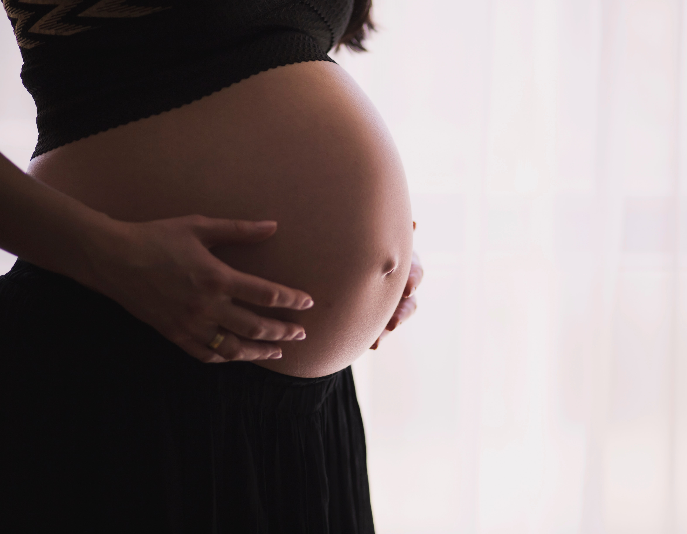
Is the COVID 19 vaccine safe to take if I am pregnant or planning to become pregnant?
Studies show all the COVID 19 vaccines are safe for pregnant women
  No increased risk for miscarriage, premature births or other complications
CDC recommends COVID 19 vaccination for pregnant women or before pregnancy if possible:
  “Vaccination programs should target women early in pregnancy or before conception, if possible.”
The American College of Obstetricians and Gynecologists and the Society for Maternal-Fetal Medicine recommend COVID-19 shots for all pregnant women
https://wwwnc.cdc.gov/eid/article/27/10/21-1394_article
https://www.researchsquare.com/article/rs-798175/v1
https://www.acog.org/covid-19/covid-19-vaccines-and-pregnancy-conversation-guide-for-clinicians

Slide 15
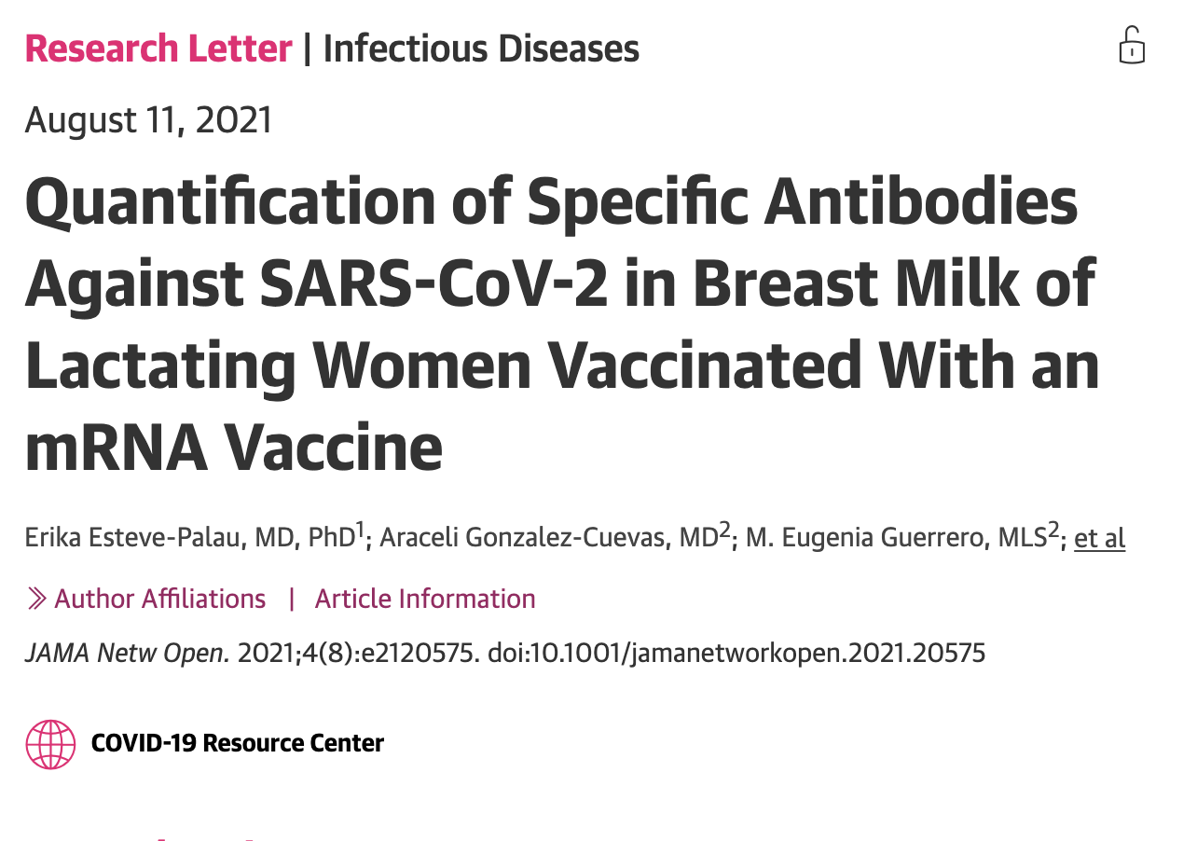

Slide 16
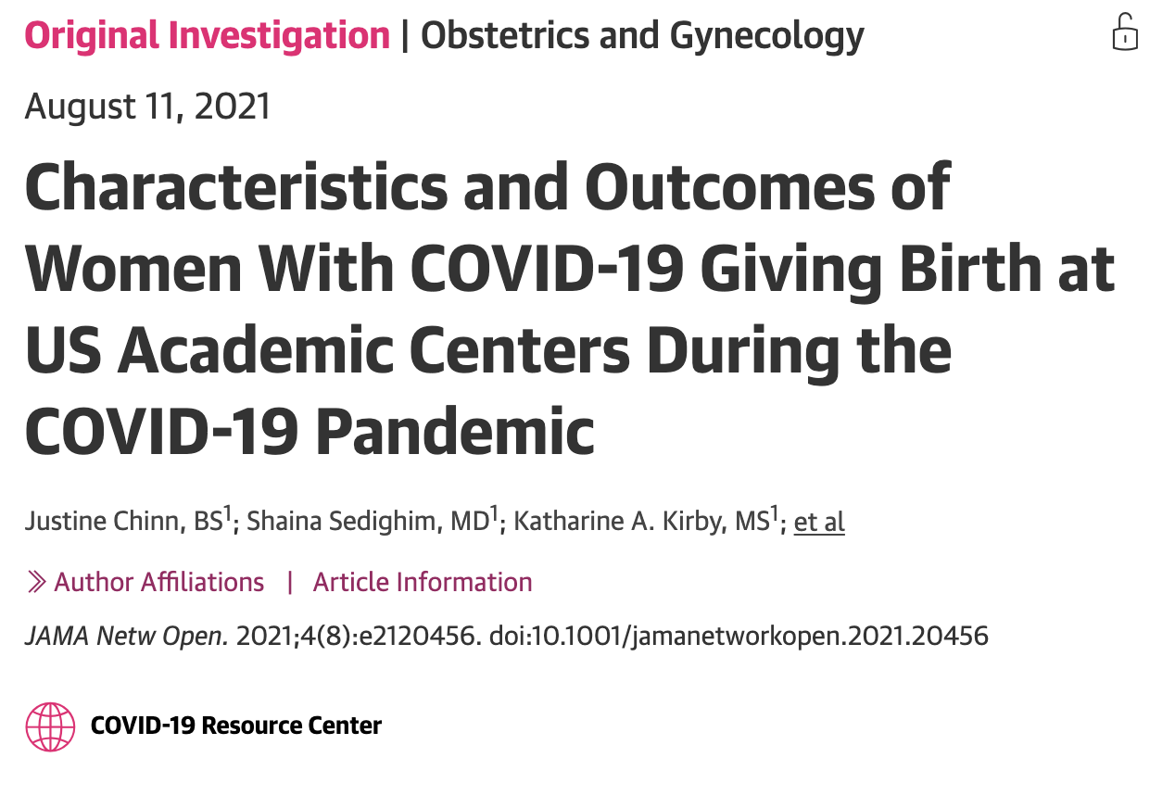
This Study showed:
Of 869,079 women, 18,715 (2.2%) had COVID 19
Women with COVID 19 infections during their pregnancy had:
  Increased risk for pre-term delivery
  5 times more likely to be admitted into the ICU
  3 times more likely to need a ventilator
  10 times increase in risk of dying

Slide 17
Does the COVID 19 vaccine cause sterility or infertility?
“There's no evidence or even biologic plausibility that COVID 19 vaccines cause infertility in either men or women” – Denise J. Jamieson, MD, MPH, professor and chair, Department of Gynecology & Obstetrics, Emory University School of Medicine; member, ACOG Practice Advisory on COVID-19 Vaccines and Pregnancy
People who have received any of the 3 COVID 19 vaccines have not had any increased complications with pregnancy compared to before the pandemic began
Because the COVID 19 vaccines do not last in your body or change anything inside your cells, it is not possible for the vaccines to have long term side effects or affect fertility in the future
https://www.ama-assn.org/delivering-care/population-care/denise-jamieson-md-mph-covid-19-vaccines-during-pregnancy

Slide 18
What can we expect in the future for COVID 19?
You have a dedicated leadership team
They have your back and want you to be healthy and safe
Things can improve but only if we all do our part
We will be transparent with information and expectations

Slide 19
What can we do to make things better?
  Even if you are vaccinated, be diligent
  Wear your mask if you are indoors
  If you have questions, ask them! If we do not know the answer, we will research the answer
  Be proud of what each one of you have done, you have saved lives, helped the most vulnerable in our society, and have made our community a better and safer place
  You are important to the residents and your coworkers
  Your expertise will make the world of difference during this time

Slide 20
Thank you for all you do every day!

Slide 21
Questions?

