Slide 1
Understanding Moral Distress & Injury
Alex Donovan, BCC
September 1, 2020

Slide 2
In the next 30 minUtes
Defining Moral Distress
Defining Moral Injury
“The War Inside”
Poll
Questions?
Brief Meditation

Slide 3
Life Threat (traumatic injury)
Loss (grief injury)
Inner Conflict (moral injury) BURNOUT
Wear & Tear (fatigue injury)
We are experiencing unusually high amounts of ALL of these types of injury right now.

Slide 4
References
Asken, Michael J.: “Now it is Moral Injury: The COVID-19 pandemic and moral distress.” Medical Economics, April 29, 2020. https://www.medicaleconomics.com/news/now-it-moral-injury-covid-19-pandemic-and-moral-distress
Doehring, Carrie: Coping with moral struggles arising from coronavirus stress: Spiritual self-care for chaplains and religious leaders. https://chaplaincyinnovation.org/wp-content/uploads/2020/03/Doehring-2020-Coping-with-moral-struggles-arising-from-coronavirus-stress.pdf?fbclid=IwAR2HSMb9bMz7vy5GRa5uYYXzBA8YctAJ8acBu-NTF2Vz7SQzOGbat2VVBcU
Rushton, Kaszniak, and Hallifax: A Framework for Understanding Moral Distress among Palliative Care Clinicians, Journal of Palliative Medicine, vol. 16 2013. https://www.upaya.org/wp-content/uploads/2014/10/JPM-framework-for-moral-distress.pdf
All images in these slides taken from: The Shay Moral Injury Center (Volunteers of America) voa.org/moral-injury-war-inside

Slide 6
Moral Distress
Moral Distress: arises when we are aware of a moral problem, determine a remedy, but cannot act on it due to external or internal constraints.
“The pain or anguish affecting the mind, body, or relationships in response to a situation in which the person is aware of a moral problem, acknowledges moral responsibility, and makes a moral judgment about the correct action; yet as a result of real or perceived constraints, participates in perceived moral wrongdoing”†
Or more simply: the constant strain of having to weigh competing values in the middle of a crisis.

Slide 7
Moral Distress – Examples:
Wondering if you are jeopardizing your family by seeing patients with COVID
Not being able to spend the same amount of time or energy on a patient like you normally would due to high demand and thinner staff teams
Having to decide when is the right time to bring a hospice team into a facility (constantly weighing the values of care for the dying with protection of other residents)
Having to stay home from activities like protests, service opportunities, or social gatherings due to health concerns or concerns for your patients or family (competing values) – or going to those things and wondering if you are jeopardizing your patients or your family
Knowing that the patient would benefit from a priest but not being able to bring one in due to concern for other patients
Sheltering at home because you’re older or immunocompromised when you know your skills could really be helping (whether it’s in healthcare or volunteering at the soup kitchen)
Being told you can’t see patients when you know they need you
Being asked to see patients when you know it’s a health risk to you, or when you are at the end of what you have to give.
The repeated question of: do I take my mask off when a patient asks me to? Constantly being torn between the human impulse and what’s safe or correct. The trade off between human needs (hugs) and healthcare needs (safety) and the constant weighing of those two.
I thought I was a good nurse but…. I thought I was the kind of person who always showed up in someone’s suffering but…
Survivor’s Guilt: I feel bad for feeling relieved (such as that COVID hasn’t hit your family like it has hit others…)

Slide 8
Moral INjury
Moral Injury: A psychological wound as a result of a morally transgressive act (either witnessed or participated in).
Like PTSI, this constellation of symptoms and causes arose out of observations of soldiers returning from wartime, but the concept very much applies to any of those who are forced to partake in or witness actions that in “normal life” would absolutely go against their morals or values.
“I would never have done this under normal circumstances or in ‘normal life’.”

Slide 9
Examples
Examples:
Wartime setting:
Being ordered to kill civilians,
Feeling guilty for your relief that the bombing hit others and not you
Healthcare:
Removing a ventilator from an older patient and giving it to a younger patient due to shortages (and based on triage policy)
Having to tell families they can’t come visit their dying loved ones, especially if that person dies before the family is able to visit.
Having to say no to requests to visit a dying patient (to give last rites, to provide support, to provide cares…) due to concern for your health, your family’s health, or due to external constraints (company or facility policy)
The distress can be higher if we have to make the decision on our own, if the constraints are perceived to be subjective. There’s more room for guilt and second-guessing.

Slide 10
“The War Inside”
Video by Volunteers of America: https://www.voa.org/the-war-inside (4 min)

Slide 11
Signs & Symptoms
Moral Distress:
“Could’ve should’ve would’ve”
Rumination, beating yourself up, inability to stop thinking about/second-guessing a decision you made
“Moral Distress may undermine empathy, cause personal distress, and lead to moral outrage, burnout, or acute secondary stress.” (Halifax)
Moral Injury:
Anger
Sadness
Helplessness
Loss of faith
Who am I now that I’ve had this experience? (existential crisis: “I thought I was a good person; I thought I was a good nurse/physician/social worker…”)
A “mix of dread, guilt, and shame” (Halifax)
SHAME

Slide 12
Poll
What symptoms of moral distress are we all experiencing? 1. Ruminating, beating yourself up, inability to stop thinking about or second guessing a decision
2. A sense of guilt or shame about not seeing patients, or not being with them more
3. A diminished sense of purpose or motivation
4. A diminished sense of self worth
5. Loss of faith in self, your calling, your company, God, or a benevolent universe
6. Crisis of identity: who am I now, who am I when things get hard, who am I if I’m not the hero others see me as?
7. Anger or moral outrage: How dare people not wear masks; how dark someone ask me to visit a patient and put myself at risk; how dare they not allow me to see my patients or allow family members to visit…
8. Feelings of pervading sadness
9. Feelings of helplessness or hopelessness

Slide 13
How we can help ourselves
Meaningful relationships: talk with trusted peers about our dilemmas and injuries. This is how we combat the shame that keeps this injury hidden.
Small victories v. perfectionism. What went well? Where did we help? 3 Good Things Program
Journaling, expressive therapies
Finding meaningful outlets for our moral outrage and grief (protests, writing…)
Mindfulness practices to help with self awareness and self-regulation, helping us to make decisions out of a place of non-anxiety
“This is a time to make use of psychological support services. It is a time to be honest with oneself. It is a time to frequently monitor one’s stress and coping and to listen to others who may be voicing concerns in caring about you. Most health systems have scaled their professional assistance programs to meet the psychological demands of this pandemic and provide valuable short term and more extended support for providers and their families.” †

Slide 14
How we can help others
Walk with others through difficult decisions; become aware of ways we may be placing people in ethical conflict. Become aware of ways that to avoid our own discomfort, we may outsource decision-making to our teammates and put them in distressing situations instead of sharing the decision-making.
Ex: asking someone to visit a patient at 4:45pm on a Friday, putting them in the position to have to say no. Or asking an elderly minister to officiate a large funeral when you know they should say know for their own safety.
Making others aware of a need (and asking them to help with that need) opens them up the moral distress if they are unable to help be part of the solution and especially if they are not kept in the loop about the result.
We can become guardians of one another’s wellbeing by having clear communication and being willing to not keep passing the anxiety buck.
Be open to listening to stories of distress; don’t dismiss the dilemma (“don’t worry, you did the best you could”) but really hear the struggle: “I hear you trying to honor your family and also your calling at the same time. It sounds like that’s really tearing you in two directions.”

Slide 15
As organizations/Leaders:
“Action to prevent or mitigate the development of moral injury begins with assuring resources are available, protocols are consistent, clear and communicated and environments are as safe as possible.” †
Clearly communicated and agreed upon guidelines even if these change
Communicating that we are in this together, and acknowledging that this is not “business as usual.”
(Hospital setting): clear triage rules: how are we making our difficult decisions? What is our protocol?
A separate triage team that is not connected to the clinical team (remove the decisions from those on the ground)
Programs like RISE (Resilience In Stressful Events) – Johns Hopkins

Slide 16
Additional resources
“Stress First Aid Model”, Dr. Patricia Watson, National Center for PTSD
The Schwartz Center for Compassionate Healthcare
“Leading with Compassion: Supporting Healthcare Workers in a Crisis”
“Caring for yourself & others during the COVID-19 Pandemic”
Matt Norvell and the RISE Program at John’s Hopkins (Resilience In Stressful Events)
Introduction to the RISE Model
Duke’s “Three Good Things” Resilience Tool: https://www.hsq.dukehealth.org/tools/
The Shay Moral Injury Center, Volunteers of America: https://www.voa.org/moral-injury-war-inside . All images in this slideshow are originally from the VOA Shay Center website.
Doehring, Carrie: Coping with moral struggles arising from coronavirus stress: Spiritual self-care for chaplains and religious leaders. https://chaplaincyinnovation.org/wp-content/uploads/2020/03/Doehring-2020-Coping-with-moral-struggles-arising-from-coronavirus-stress.pdf?fbclid=IwAR2HSMb9bMz7vy5GRa5uYYXzBA8YctAJ8acBu-NTF2Vz7SQzOGbat2VVBcU
Asken, Michael J.: “Now it is Moral Injury: The COVID-19 pandemic and moral distress.” Medical Economics, April 29, 2020. https://www.medicaleconomics.com/news/now-it-moral-injury-covid-19-pandemic-and-moral-distress
Rushton, Kaszniak, and Hallifax: A Framework for Understanding Moral Distress among Palliative Care Clinicians, Journal of Palliative Medicine, vol. 16 2013. https://www.upaya.org/wp-content/uploads/2014/10/JPM-framework-for-moral-distress.pdf

Slide 17
Questions? Thoughts?

Slide 18
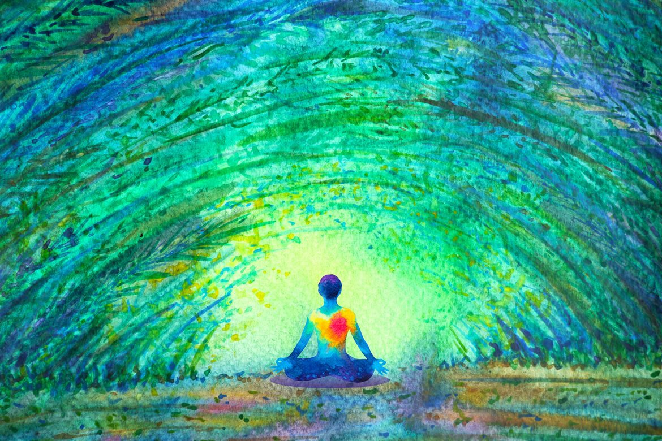
Mindfulness Meditation For Moral Distress

Slide 19
Alexandra.Donovan@compassus.com
720.429.1625

