Slide 1
Self-care and Leadership in a Time of Crisis – We are all Human
Lea C. Watson, MD MPH
Geriatric Psychiatry Consulting and Training, LLC

Slide 2
“The expectation that we can be immersed in suffering and loss daily and not be touched by it is as unrealistic as expecting to be able to walk through water without getting wet.”
Rachel Naomi Remen

Slide 3
Anyone having weird dreams?
This google search quadruped in last two weeks
Increases with sleep deprivation (proportionately more REM sleep)
Many people have anxiety dreams - but just don’t remember them
It is normal

Slide 4
We are all experiencing grief and loss
Normal routine
Touch
Smiling at each other
Financial security
We could die too

Slide 5
Covid 19 crisis may trigger a trauma response
Scarcity
Uncertainty
Fear of dying
Loss of control

Slide 6
Trauma Informed Care
https://ncsacw.samhsa.gov/userfiles/files/SAMHSA_Trauma.pdf

Slide 7
Fear vs. Anxiety
Fear is a primitive and life-preserving response to a threat
that originates in the amygdala and activates “fight or flight.”
Anxiety is a sense of worry or dread in the absence of an imminent threat, but our bodies still react as though we are in danger.
Anxiety can be a great teacher because it signals that something “isn’t right,” but persistent anxiety can deplete us and those around us.
Is it a stick or a snake?

Slide 8
Stop anxiety loop
Anxiety is more contagious than Covid 19
What we attend to, grows
Do not deepen grooves of negative thinking
Stay present – practice “thought stopping” about past or future
Engage your senses – hold ice cube until it melts, mindfully and slowly touch/smell/eat favorite fruit, step outside and label every sound in detail

Slide 9
Get vulnerable
The antidote to trauma is attunement with others
Have “feelings” conversations
No time for comparative suffering

Slide 10
Moral injury
When you know the right thing to do, but are constrained from doing it
From military context (coined by Jonathon Shay), you are forced to “betray” what is morally right by a leadership structure outside your control in a high stakes situation
Results in shame, guilt, anxiety , anger
Litz, B.T., Stein, N., Delaney, E., Lebowitz, L., Nash, W.P., Silva, C., & Maguen, S. (2009). Moral injury and moral repair in war Veterans: A preliminary model and intervention strategy. Clinical Psychology Review, 29, 695-706.

Slide 11
Examples of moral injury for PALTC providers
Not enough PPE (putting yourself and coworkers in harm’s way)
Restricted visitation (people dying alone)
Triaging medical resources (not enough comfort meds)
Staffing shortages and underpaid workers (unsafe conditions)

Slide 12
National Academy of Sciences
Before COVID19 many clinicians faced burnout, stress, anxiety, depression, substance abuse & suicidality. This crisis is presenting workplace hardships & moral dilemmas likely to exacerbate existing burnout levels.

Slide 13
Increased risk
Maintaining sobriety or new SUD
Child abuse – reports up 10-20%
Intimate Partner Violence – calls up 30%

Slide 14
Factors increasing suicide risk
Economic stress
Social isolation
Decreased access to community and religious support
Barriers to MH treatment
Medical problems
Increased anxiety
Firearm sales
Reger MA, Stanley IH, Joiner TE. Suicide Mortality and Coronavirus Disease 2019—A Perfect Storm? JAMA Psychiatry. Published online April 10, 2020. doi:10.1001/jamapsychiatry.2020.1060

Slide 15
Self-preservation (a.k.a. who has time for yoga?)
Eat
Sleep
Move
Daylight
Connect

Slide 16
Self- care
Schedule pleasant activities
Drop the guilt
Keep normal hours - be a role model
Exercise – heart rate up for minimum 20 minutes
Develop or extend positive habits and goals
If you have a therapist, call them; low threshold for getting one

Slide 17
What distinguishes a great leader?
Listening
Trust and transparency
Empathy
Sees crisis as a time of opportunity – new ways, new voices
Angood, P. M. (2014). The Value of Physician Leadership. Retrieved from www.ACPE.org.

Slide 18
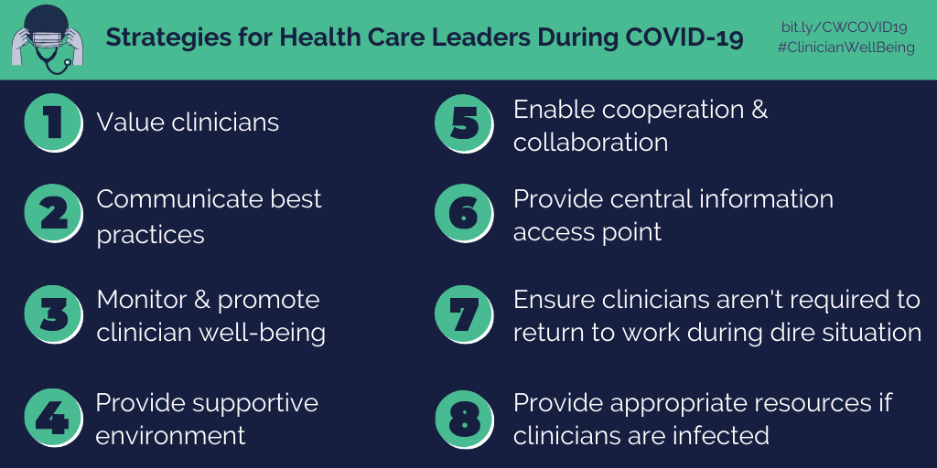

Slide 19
Build trust and community
Say what you will do, do what you say
All staff huddles - daily communications
Celebrate wins
Validate interdependence – all team members matter the most
Set intention – offer inspirational quote/silence

Slide 20
Battle buddy
Formally arrange with peer leader from another place
to text or call each either once/day
Agree to terms – take turns listening
Share stories, tips, wins and losses
Keep on speed dial

Slide 21
Control what you can
Order supplies
Complete ACP’s
Obtain I-pads
Reduce unnecessary med passes
Plan for how you will cohort residents if necessary
Stay agile and humble

Slide 22
Summary
We are all living through a trauma – it’s a big deal
PALTC clinicians are heroes at the front lines – THANK YOU, THANK YOU
We must pace ourselves and care for ourselves so that we can lead
Risks for negative personal outcomes are very high – get help
It will end and things will be different – some things even better

Slide 23
Crisis hotlines
Suicide hotline: 1-800-273-8255
https://suicidepreventionlifeline.org/
Intimate Partner Violence: 1-800-787-3224
https://www.thehotline.org/
If unable to speak safely:
text LOVEIS to 22522

Slide 24
A full range of self-care resources on PALTC foundation website
https://www.paltcfoundation.org/node/346
Podcast on self care
https://paltc.podbean.com/e/covid-19-effects-on-mental-health/
Please reach out privately via email if I can lend an ear or help point you in the right direction.
lea@leawatsonmd.com

